Slide 1

Arrays
University of Human Development College of Science and Technology Department of IT
Lecture :Programming
Lecturer: Tara Qadr
1st stage 2015-2016

Slide 2
Objectives
Introducing arrays
Declaring array variables, creating arrays, and initializing arrays
Copying contents from one array to another
Search and sorting methods
Multidimensional arrays

Slide 3
Arrays
It is often necessary to deal with collections of related variables,
e.g., consider storing the marks of 20 students, then finding the average.
Declare separate variable for each student:
int studentMark1 = 60;
int studentMark2 = 72;
...
int studentMark19 = 59;
And how would we manipulate 20 variables declared in this way?
What if we wanted to add new student?
What if we wanted to know how many students are above the average?

Slide 4
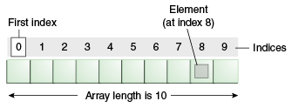
Arrays
Is a data structure, which stores a fixed-size sequential collection of elements.
All elements of array has the same data type.
Arrays in Java are objects.
Arrays must be allocated.
Arrays are passed by reference.
Arrays are 0-based.

Slide 5
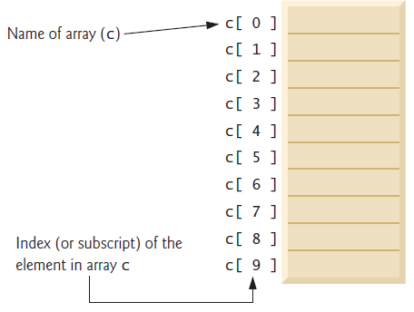
Type of arrays
Single Dimensional Array
Multi dimensional Array
General syntax for creating Single array:
arrayName = new datatype[arraySize];
Examples:
int studentMark = new int [20];
double c = new double [10];
String studentName = new String [95];
--Once an array is created, its
size is fixed. It cannot be
changed.

Slide 6
Declare, Create, and initialize Arrays
Another way to declare, create and initialize arrays (by using shorthand notation:
int[] c = { -45, 6, 0, 72, 1543, -89, 0, 62, -3, 1};
Using the shorthand notation, you have to declare, create, and initialize the array all in one statement. Splitting it would cause a syntax error.
For example, the following is wrong:
int[] c;
c = { -45, 6, 0, 72, 1543, -89, 0, 62, -3, 1};

Slide 7
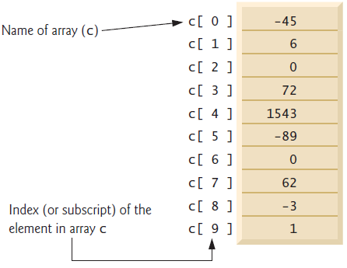
Initializing Arrays
c[0] = -45;
c[1] = 6;
c[2] = 0;
...
c[9] = 1;

Slide 8
Initializing Arrays (Cont.)
Using loop:
for (int i = 0; i < c.length; i++)
c[i] = i;
c.length returns size of the array c which is 10.

Slide 9
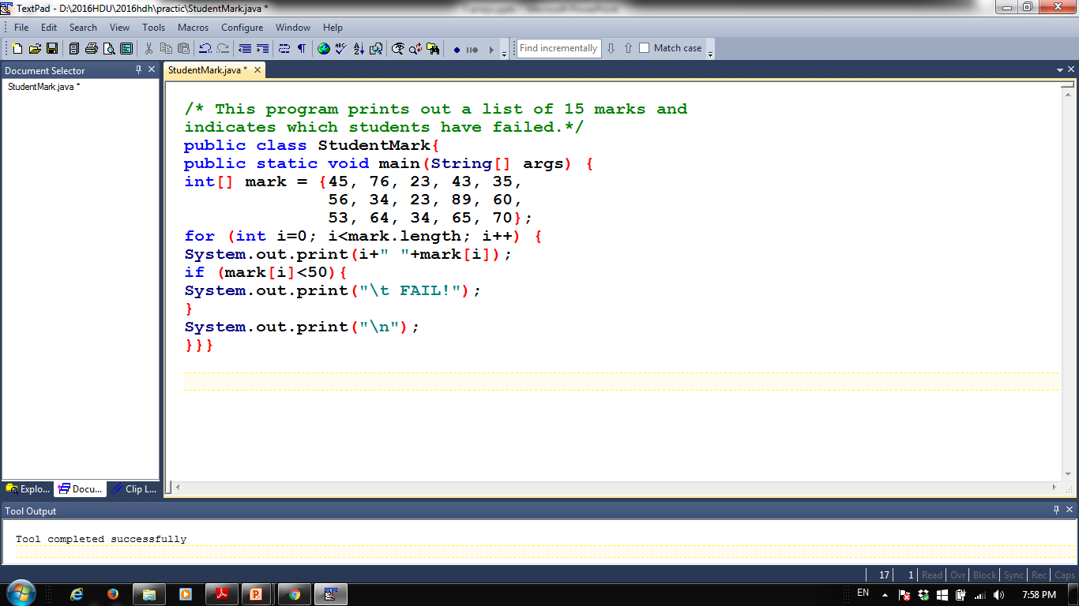
Example

Slide 10
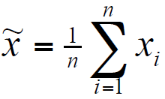
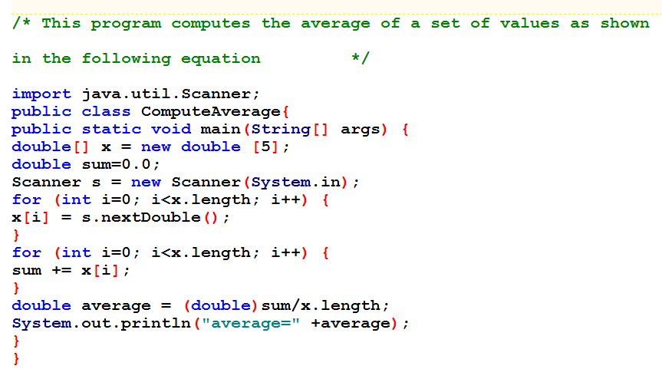
example

Slide 11
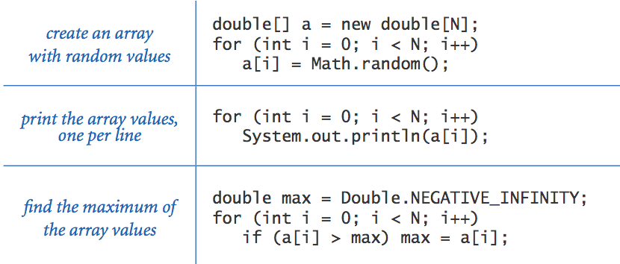
Array-Processing Examples

Slide 12
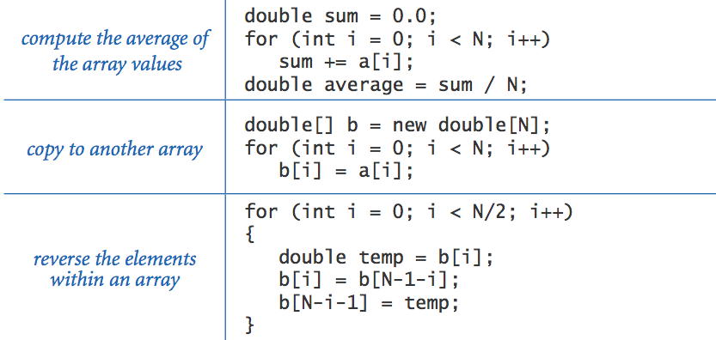
Array-Processing Examples

Slide 13
Exercise
1.Write a program that displays a bar-chart based on the number entered by the user. For example:
numbers entered by the user: 5 1 8 4
output:
*****
*
********
****
2. Generate 100 lowercase letters randomly and assign to an array of characters, count the occurrence of each letter.
3. Write a program to check if the word “computer” found in a text or not, if found display its location.

Slide 14
Two Dimensional Arrays
Table of grades for each student and assignments.
Table of grayscale values for each pixel in a 2D image.
Declaring and Creating Two Dimensional Arrays
int[][] matrix = new int[10][10];
Or
int matrix[][] = new int[10][10];
Two subscripts are used in a 2D array.
One for the row and
The other for the column.
As in a one-dimensional array, the index for each subscript is of the int type and starts from 0

Slide 15
Initializing 2D Arrays
matrix[0][0] = 3;
matrix[0][1] = 25;
Initializing all elements of a 2D array, using nested loop.
for (int i= 0; i< matrix.length; i++) {
for (int j = 0; j < matrix[i].length; j++) {
matrix[i][j] = (int) (Math.random() * 1000);
}
}

Slide 16
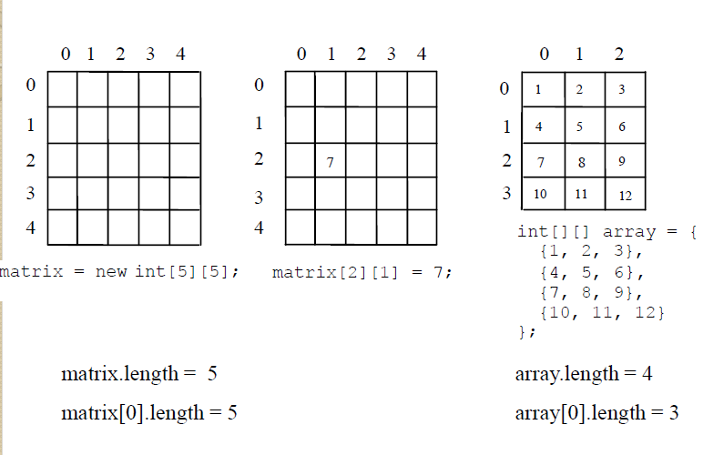
Two-dimensional Array Illustration

Slide 17
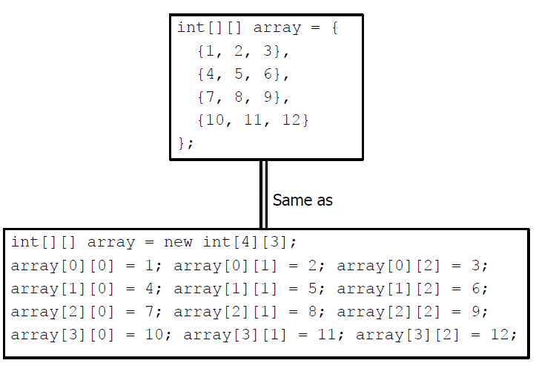
Declaring, Creating, and Initializing Using Shorthand Notations

Slide 18
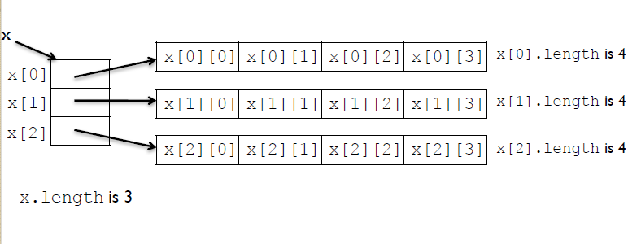
Lengths of Two-Dimensional Arrays
int[][] x = new int[3][4];

Slide 19
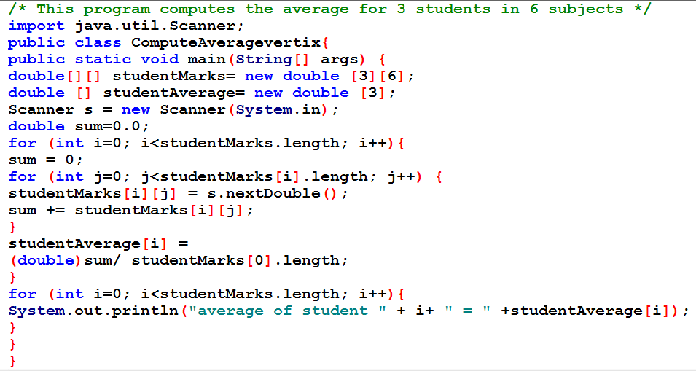
2D array example

